Slide 1
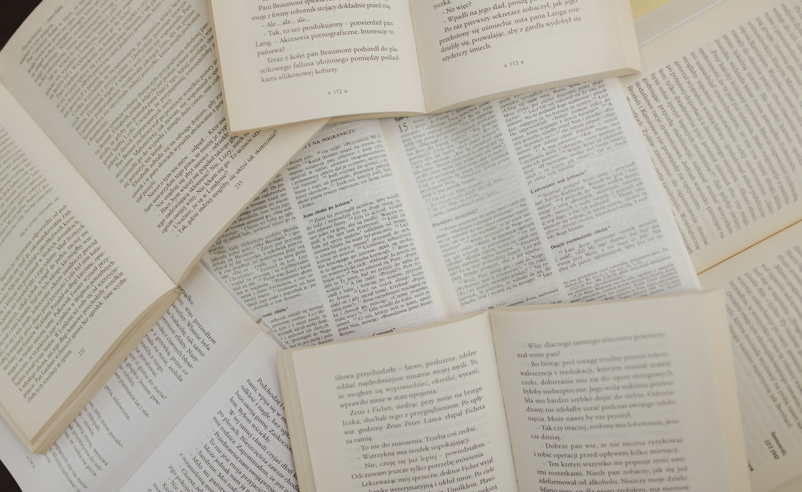

A web-based Digital Library for finding similar image using Neural Network
Do Dong Quan - ITITIU19043

Slide 2
Table of Contents
1
INTRODUCTION
2
LITERATURE REVIEW
3
METHODOLOGY
4
IMPLEMENT & RESULTS
5
EVALUATION
6
CONCLUSION & FUTURE WORKS

Slide 3
Introduction
1
Background:
High demand for
Online research.
Manage the library's resources easier.
Diverse search methods.
2
Problem Statement
Time-consuming & information overload.
Mistakes during managing resources of library.
The simple way for searching books.
3
Objective
Digital library & admin dashboard systems.
Image searching.
A machine learning model for finding similar image.

Slide 4
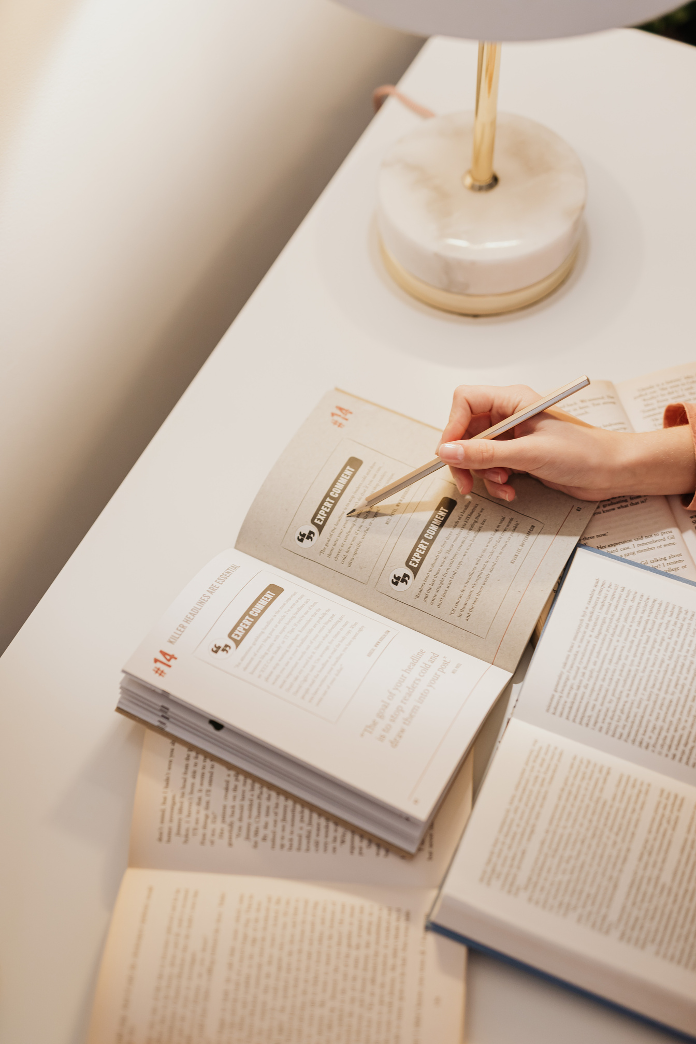
Literature Review
1
Content-based image retrieval
2
Summary research

Slide 5
Literature Review
Digital Library
Space and document savings
Easy search and access
Diversification of information sources
Finding Similar Image
Efficient image retrieval
Enhanced user experience
This thesis chooses Content-based image retrieval (CBIR) as the main option

Slide 6

Literature Review
Content-based image retrieval (CBIR)
Utilizes computer vision algorithms to retrieve images based on their content (color, shape, texture, etc)
Searches large databases for images that closely match the query image.
Application of CBIR
Crime prevention, medicine, historical research, and biodiversity information systems

Slide 7
Literature Review
 | Features | This thesis
Latif, A., Rasheed, A., Sajid, etc [1] | Convolutional Neural Network (CNN) | ☒
Latif, A., Rasheed, A., Sajid, etc [31] | Autoencoders | ☐
Latif, A., Rasheed, A., Sajid, etc [31] | Generative Adversarial Networks (GAN). | ☐
Muhammad Imran Razzak [2] | LeNet | ☐
Muhammad Imran Razzak [33] | ResNet | ☐
Muhammad Imran Razzak [33] | VGGNet | ☒
A. Alzu’bi, A. Amira và N. Ramzan [3] | Euclidean distance | ☒
A. Alzu’bi, A. Amira và N. Ramzan [32] | Cosine Similarity | ☐
A. Alzu’bi, A. Amira và N. Ramzan [32] | Chi-square distance | ☐
Related Works
Latif, A., Rasheed, A., Sajid, U., Ahmed, J., Ali, N., Ratyal, N. I., ... & Khalil, T. (2019). Content-based image retrieval and feature extraction: a comprehensive review. Mathematical problems in engineering, 2019.
Razzak, M. I., Naz, S., & Zaib, A. (2018). Deep Convolutional Neural Networks for CBIR: A Survey. Journal of Computer Science and Technology, 33(1), 11-30
Alzu’bi, A., Amira, A., & Ramzan, N. (2015). Semantic content-based image retrieval: A comprehensive study. Journal of Visual Communication and Image Representation, 32, 20-54

Slide 8

Methodology
1
Convolutional Neural Networks
2
VGG16 & KNN
3
System Overview
4
System Design
5
Machine Learning Model

Slide 9
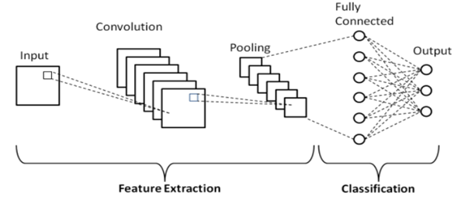
Methodology
Convolutional Neural Network (CNN)
Famous for image processing and analysis.
Learn features by using convolutional layers.
Achieved high accuracy on ImageNet datasets.
Structure of CNN [1]
Convolutional layer
Activation layer
Pooling layer
Fully-connected layer
1. Albawi, S., Mohammed, T. A., & Al-Zawi, S. (2017, August). Understanding of a convolutional neural network. In 2017 international conference on engineering and technology (ICET) (pp. 1-6). Ieee

Slide 10
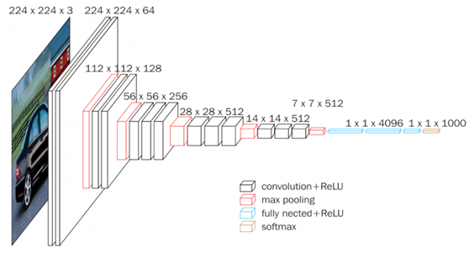
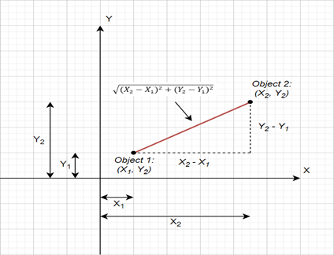
Methodology
VGG16: A famous CNN architecture [1]
1
k-Nearest Neighbor (kNN) for Classification [2]
2
1. Hassan, M. U. (2021, February 24). VGG16 – Convolutional Network for Classification and Detection. Neurohive. https://neurohive.io/en/popular-networks/vgg16/
2. A. Aylin Tokuç. (2022, November 9). k-Nearest Neighbors and High Dimensional Data. https://www.baeldung.com/cs/k-nearest-neighbors

Slide 11
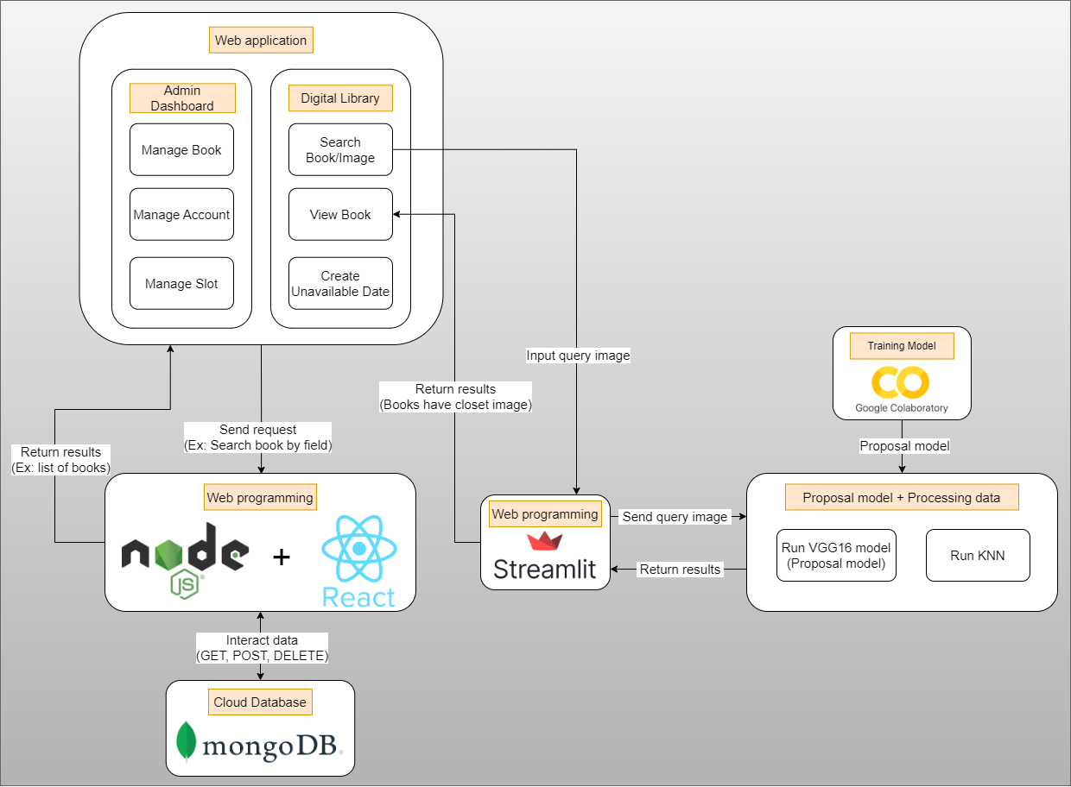
System Overview

Slide 12
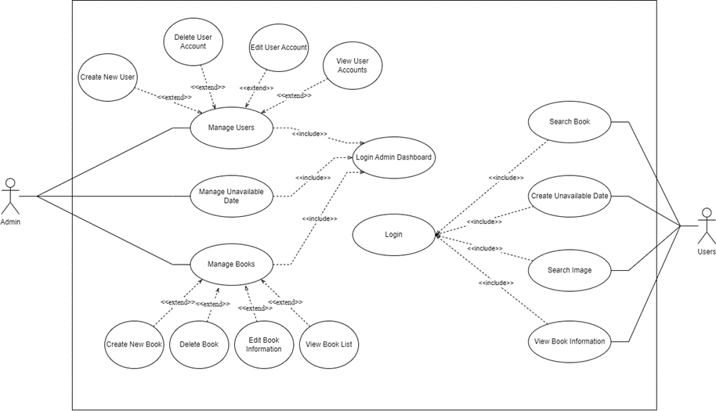
System Design
Admin Dashboard
Manage Books
Manage Account
Manage Slot
Digital Library
Search Book/Image
View book
Create unavailable date

Slide 13
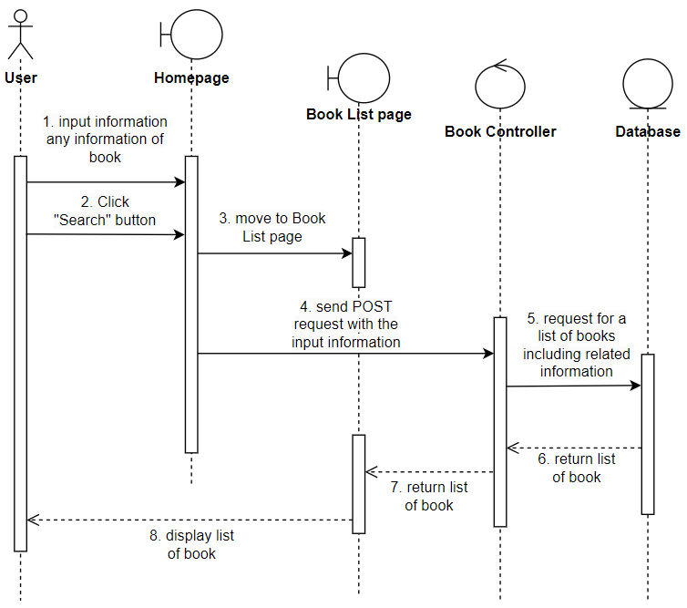
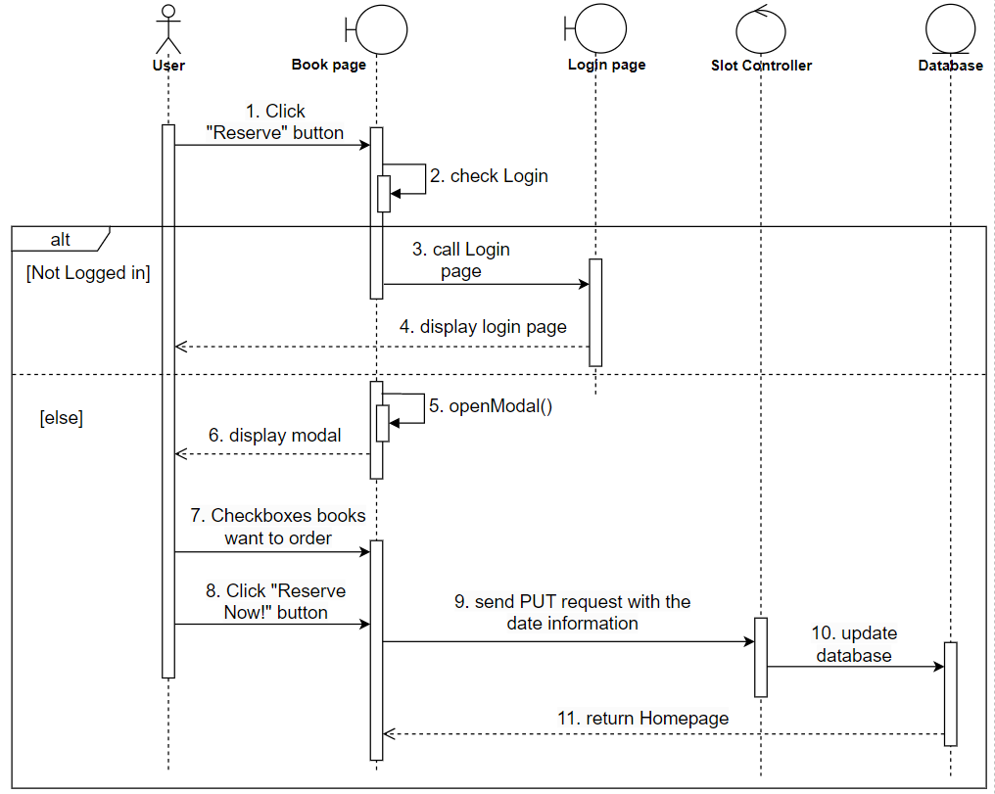
System Design
(Sequence Diagram)
Search Book
Create Unavailable Date

Slide 14
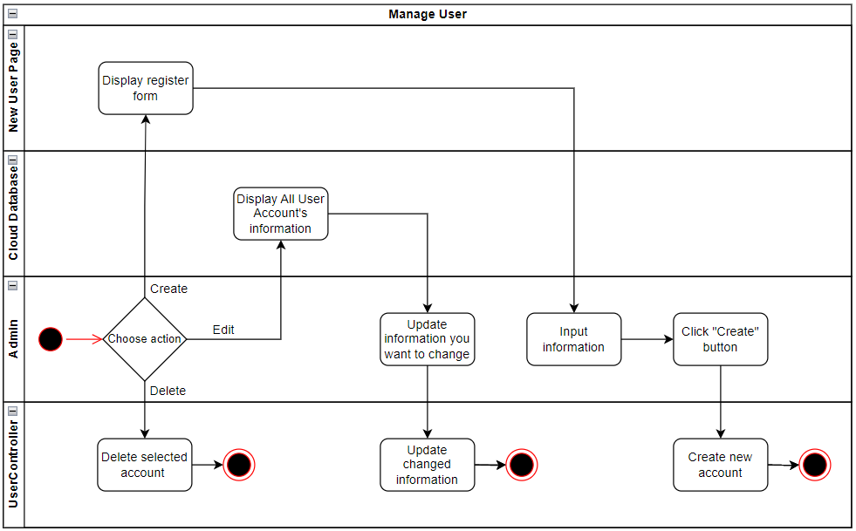
System Design
Manage User workflow

Slide 15
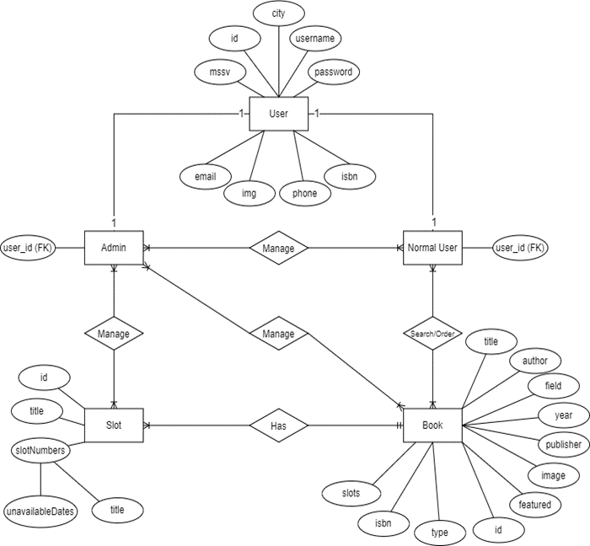
System Design
Digital Library
Entity Relational Diagram

Slide 16
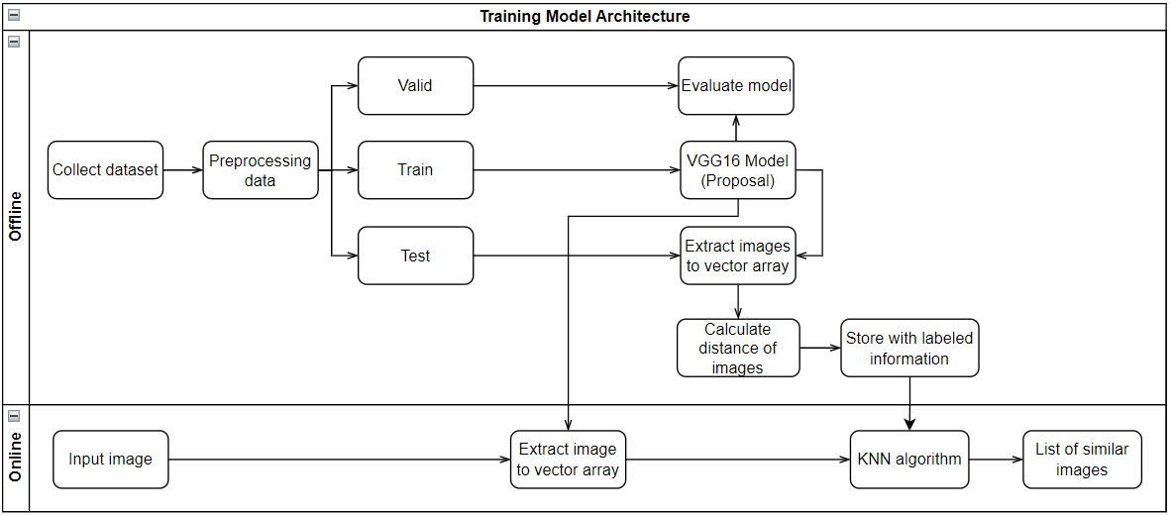
Machine Learning Model
Pipeline system for Finding similar image using Neural Network

Slide 17
Machine Learning Model
Model Architecture
 | Book Recommendation Dataset [1] | Comic Books Classification [2]
Data type | Books information | Comic-book images
Data amount | 10,000 books information | 23,000 images of comics
Used Data | 3,200+ | 3,200+
Purpose usage | Training Model, Web-app development | Training Model
Transfer learning from the VGG16 pre-trained model.
Apply layers in the proposal model such as
Flatten: flatten the output into 1D
Batch Normalization: output normalization
Dropout layer: randomly turn of neurons
Dataset
1. Book Recommendation Dataset. (2020, November 29). Kaggle. https://www.kaggle.com/datasets/arashnic/book-recommendation-dataset
2. Comic Books Images. (2017, November 21). Kaggle. https://www.kaggle.com/datasets/cenkbircanoglu/comic-books-classification

Slide 18
Implement & Result
1
Web application development
2
Machine learning model
3
Demonstration

Slide 19
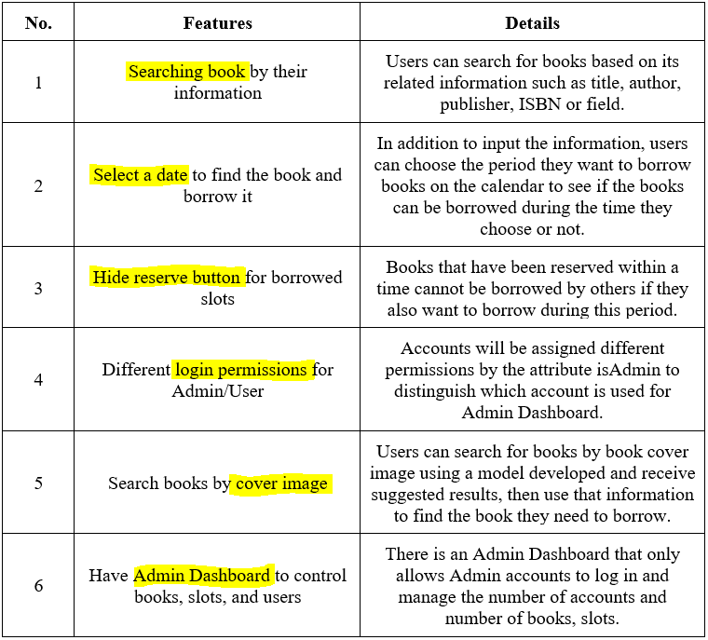
Web application
Functions list of Digital Library

Slide 20



Web application
Front-end
Build user interface
Navigate between single pages.
Receive requests from users
Back-end
Encrypting passwords
Connecting to Cloud Database
Authenticate user
Manage APIs for data interaction
Database
Store data on Cloud
Manage data easily

Slide 21
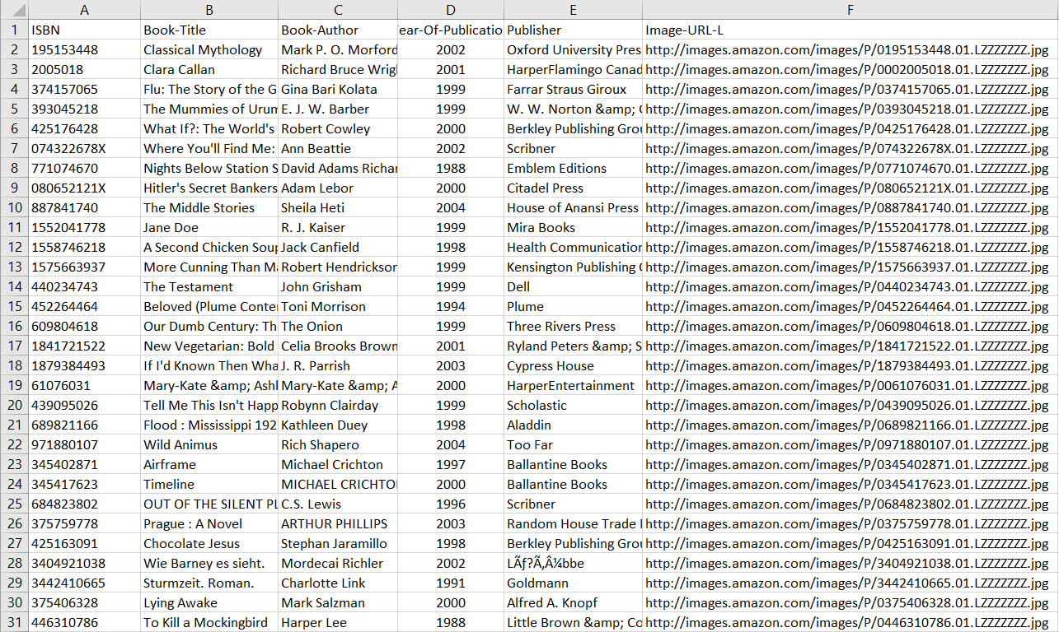

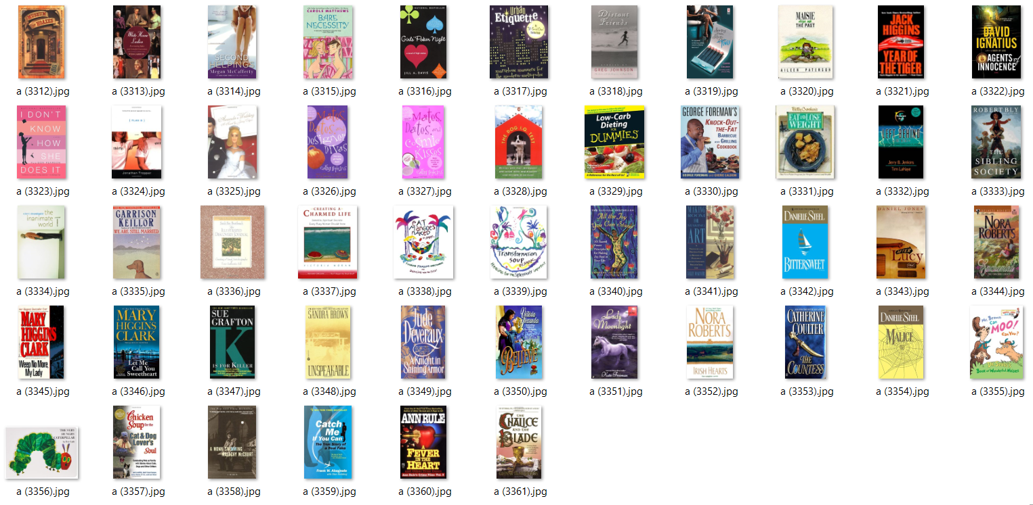
Machine Learning Model
Data preprocessing

Slide 22
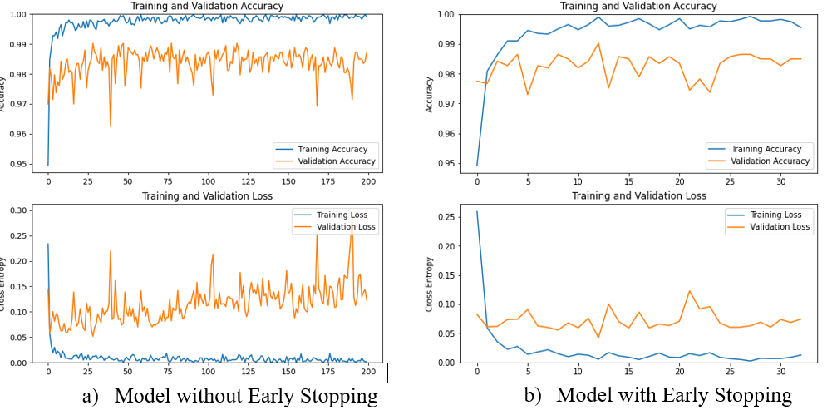
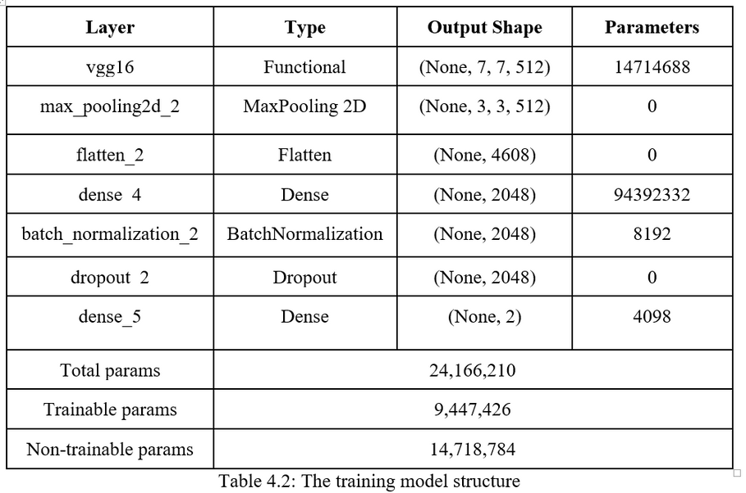
Machine Learning Model
Model Structure
The accuracy & loss

Slide 23
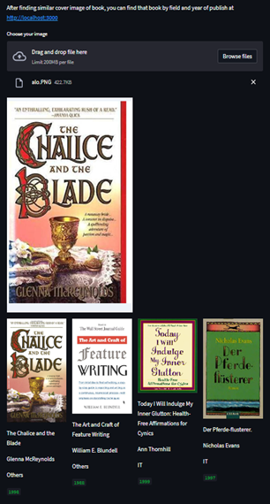
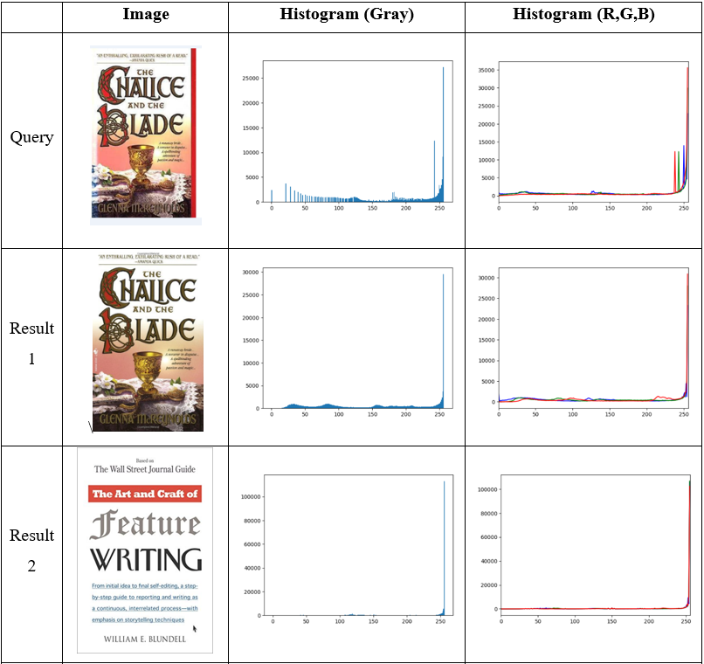
Machine Learning Model - Result

Slide 24
Demonstration

Slide 25
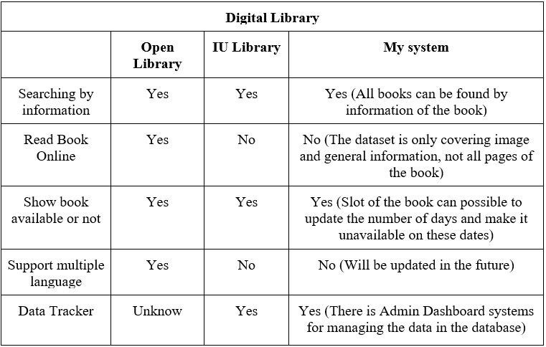
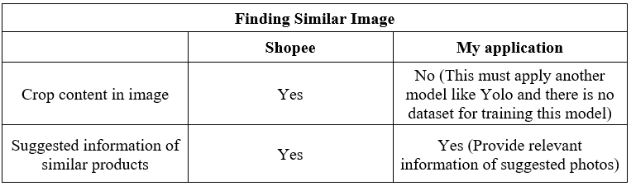
Evaluation

Slide 26
Conclusion & Future works
Conclusion
Understand the platform for building a machine-learning model.
Enhances knowledge about programming a website.
Know how to implement a digital library system in practice.
Future works
Apply a more optimized model.
Cut the main content from the query image.
Develop a complete "Digital Library" system.

Slide 27
Thank
You

